Slide 1

Artificial intelligence
Hossam Elsayed MohaMED Fakher
0 1 2 7 7 8 8 0 6 7 8
Gmail
GitHUB
Linkedin
Kaggle
S e s s i o n 6
Segmentation

Slide 2
What Is Image Segmentation?
Image segmentation is a critical process in computer vision.
Segments represent objects or parts of objects, and comprise sets of pixels, or “super-pixels”.

Slide 3
What Is Image Semantic Segmentation?
It classify all the pixels of an image into meaningful classes of objects. These classes are “semantically interpretable” and correspond to real-world categories.

Slide 4
What Is Image Instance Segmentation?
It identify each instance of each object in an image. It differs from semantic segmentation in that it doesn’t categorize every pixel.

Slide 5
Others Techniques
Thresholding
K-means Clustering
Edge Detection
divides an image into a foreground and background. A specified threshold value separates pixels into one of two levels to isolate objects. Thresholding converts grayscale images into binary images or distinguishes the lighter and darker pixels of a color image.
an algorithm identifies groups in the data, with the variable K representing the number of groups. The algorithm assigns each data point (or pixel) to one of the groups based on feature similarity. Rather than analyzing predefined groups, clustering works iteratively to organically form groups.
Identifies sharp changes or discontinuities in brightness. Edge detection usually involves arranging points of discontinuity into curved line segments, or edges. For example, the border between a block of red and a block of blue.

Slide 6
U NET
Convolutional Networks For Biomedical Image Segmentation

Slide 7
Unet Model

Slide 8
What is UpSampling2D and Conv2DTranspsoe

Slide 9
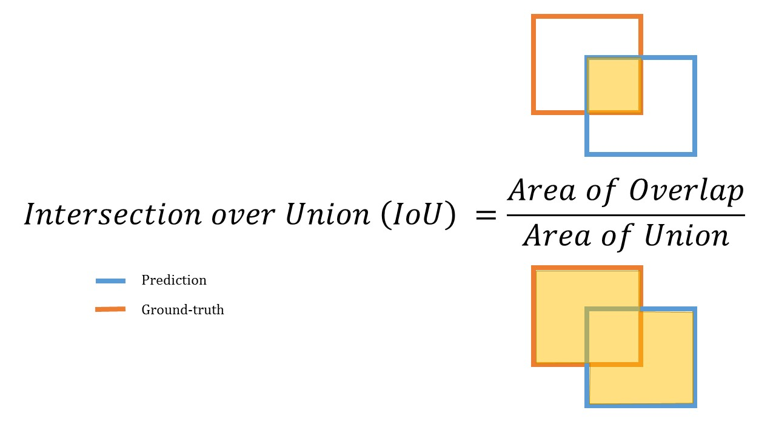
Intersection Over Union [ IOU ]

Slide 10
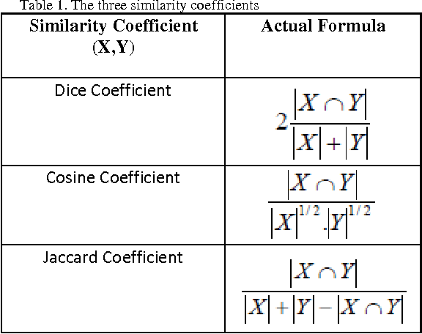
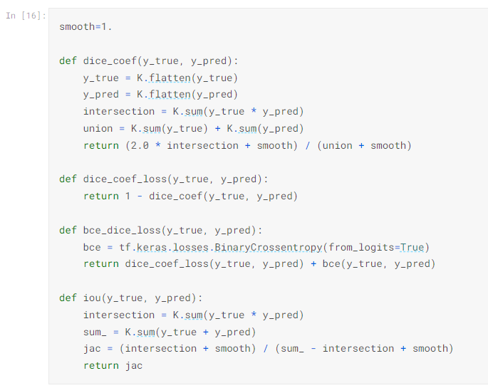
Three similarity coefficients

Slide 11
R-CNN
• Scan the input image for possible objects using an algorithm called Selective Search, enerating ~2000 region proposals.
• Run a convolutional neural net (CNN) on top of each of these region roposals.
• Take the output of each CNN and feed it into
an SVM to classify the region
a linear regressor to tighten the bounding box of the object if such an object exists.

Slide 12
R-CNN

Slide 13
Fast R-CNN
• The purpose of the Fast Region-based Convolutional Network (Fast R-CNN) is to reduce the time consumption related to the high number of models necessary to analyze all region proposals.
• Performing feature extraction over the image before proposing regions, thus only running one CNN over the entire image instead of 2000 CNN’s over 2000 overlapping regions.
• Replacing the SVM with a softmax layer, thus extending the neural network for predictions instead of creating a new model.

Slide 14
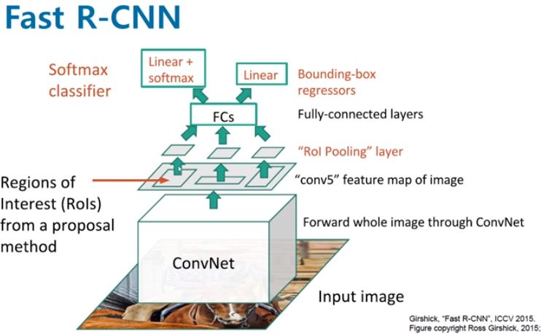
Fast R-CNN

Slide 15
Faster R-CNN
• The input image is passed through a pre-trained CNN (The original Faster R-CNN used VGG), then we use the convolutional feature map we get for the next part.
• Next, the Region Proposal Network (RPN) uses the features that the CNN computed to find up to a predefined number of regions (bounding boxes), which may contain objects. It generates multiple possible regions based on k fixed-ratio anchor boxes (default bounding boxes). RPN accelerates the training and testing processes.
• Finally, comes the R-CNN module, which uses that information to: Classify
the content in the bounding box (or discard it, using “background” as a label). Adjust the bounding box coordinates (so it better fits the object).

Slide 16
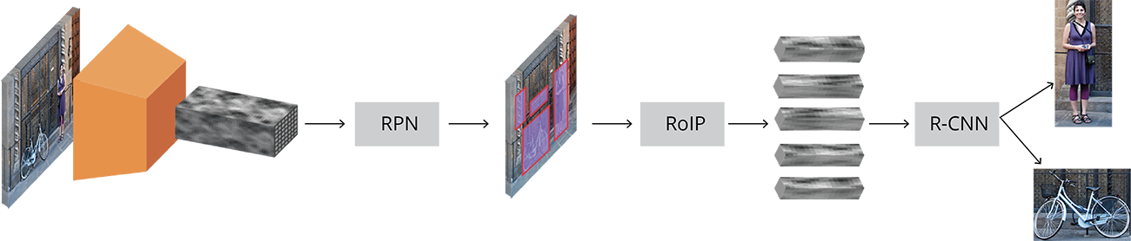
Faster R-CNN

Slide 17
Mask R-CNN
Mask R-CNN (Mask Regional Convolutional Neural Network) is a state of the art model for instance segmentation, developed on top of Faster R-CNN.
For a given image, Mask R-CNN, in addition to the class label and bounding box coordinates for each object, will also return the object mask.

Slide 18
Mask R-CNN

Slide 19
Comparison Between Models

Slide 20
Detectron2
• Detectron2 was built by Facebook AI Research (FAIR) to support rapid implementation and evaluation of novel computer vision research.
• Detectron2 is now implemented in PyTorch.
• Detectron2 is flexible and extensible, and able to provide fast training on single or multiple GPU servers.
• Detectron2 can be used as a library to support different projects on top of it.

Slide 21
Detectron2 Model Zoo
Detectron2 Model Zoo : https://github.com/facebookresearch/detectron2/blob/master/MODEL_ZOO.md

Slide 22
Detectron2 - Inference

Slide 23
Train Detectron2 On A Custom Dataset
Convert your data-set to COCO-format
The COCO dataset is formatted in JSON and has five annotation types: object detection, keypoint detection, stuff segmentation, panoptic segmentation, and image captioning. It is a collection of “info”, “licenses”, “images”, “annotations”, “categories” (in most cases), and “segment info” (in one case).

Slide 24
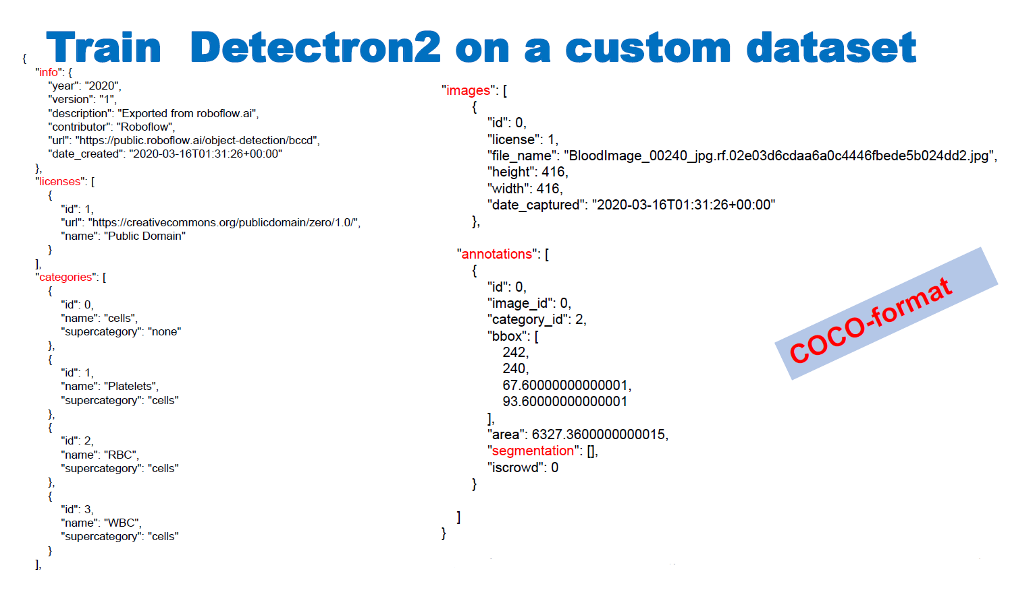

Slide 25
Train Detectron2 On A Custom Dataset

Slide 26
Train Detectron2 On A Custom Dataset
• Detectron2 keeps track of a list of available datasets in a registry, so we must register our custom data with Detectron2 so it can be invoked for training.
# Register Custom Detectron2 Data
from detectron2.data.datasets import register_coco_instances
register_coco_instances("my_dataset_train", {}, "/content/my_dataset/train/_annotations.coco.json",
"/content/my_dataset/train")
register_coco_instances("my_dataset_val", {}, "/content/my_dataset/valid/_annotations.coco.json",
"/content/my_dataset/valid")
register_coco_instances("my_dataset_test", {}, "/content/my_dataset/test/_annotations.coco.json",
"/content/my_dataset/test")

Slide 27
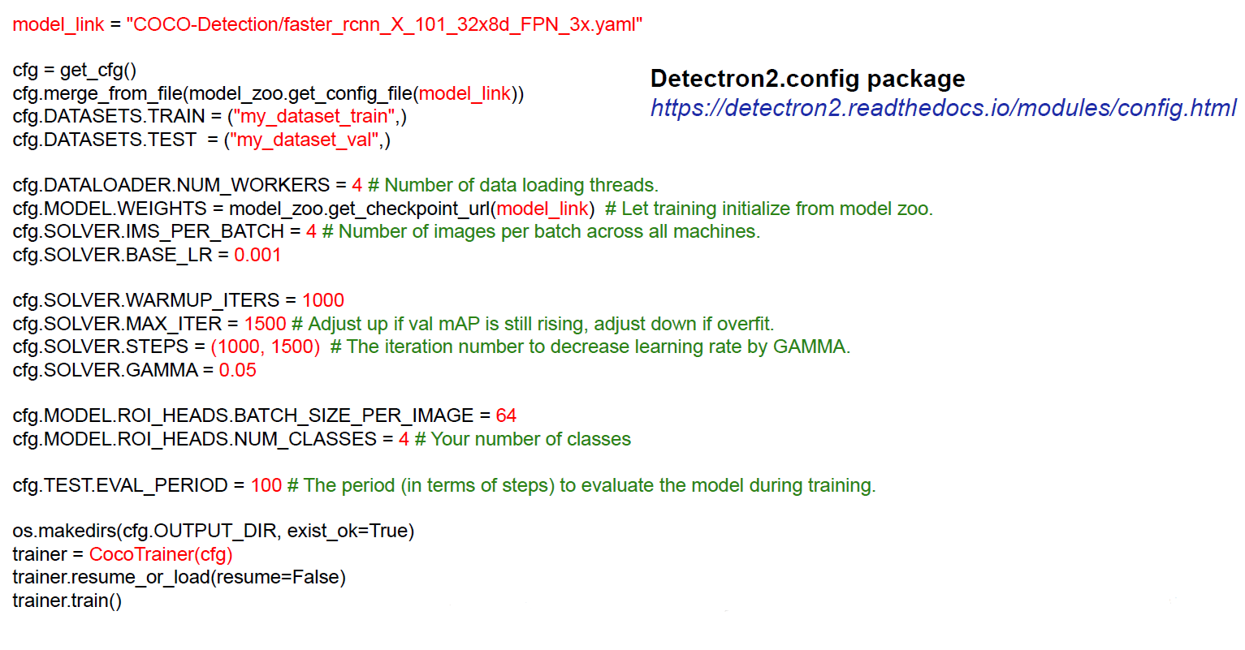
Train Detectron2 On A Custom Dataset

Slide 28
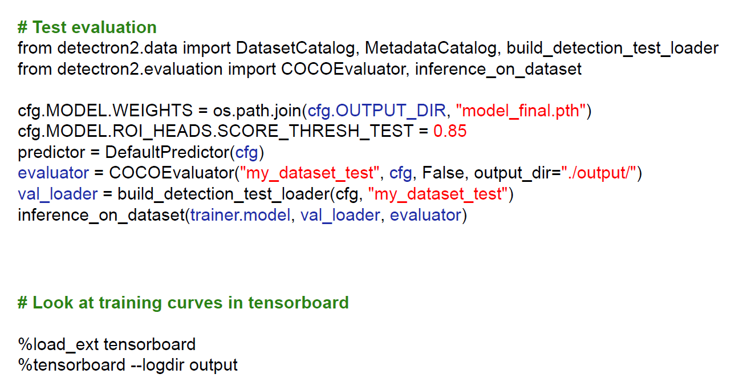
Train Detectron2 On A Custom Dataset

Slide 29
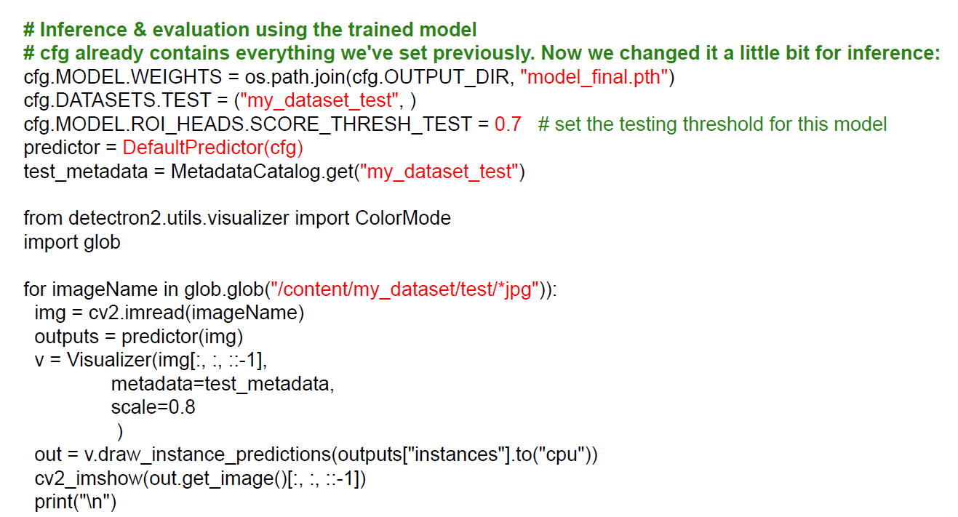
Train Detectron2 On A Custom Dataset

Slide 30
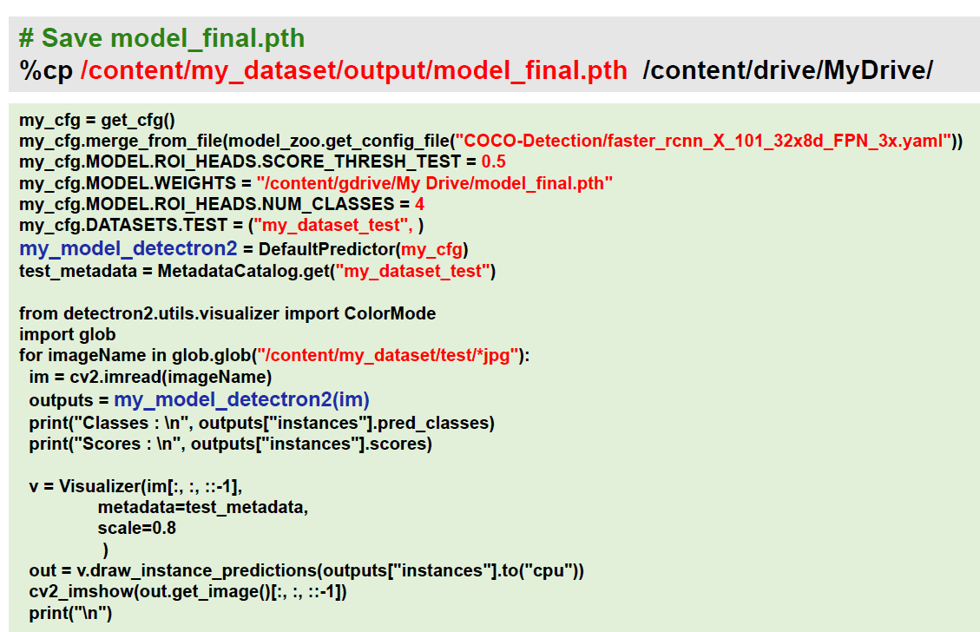
Train Detectron2 Save/Load Trained Model

Slide 31
Instance Segmentation on a custom dataset
labelme

Slide 32
Thanks for listening

